Slide 1
Scenery with a moving car
Members:
Rownak, M. R. 17-33376-1
Siddika, Rukaiya 17-34449-1

Slide 2
Day & Night view

Slide 3
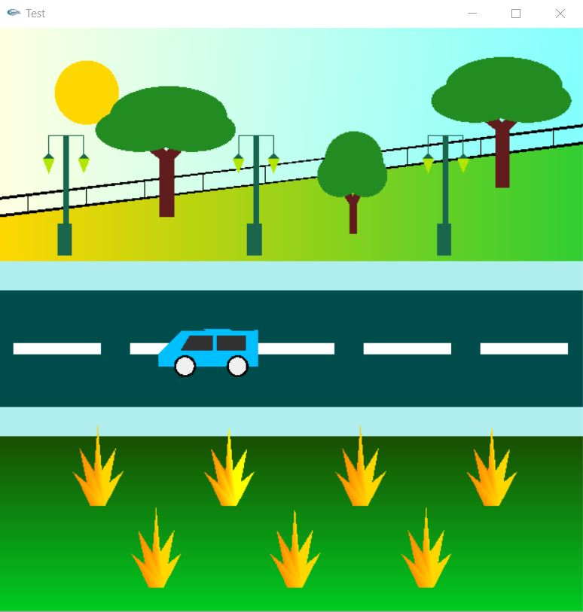
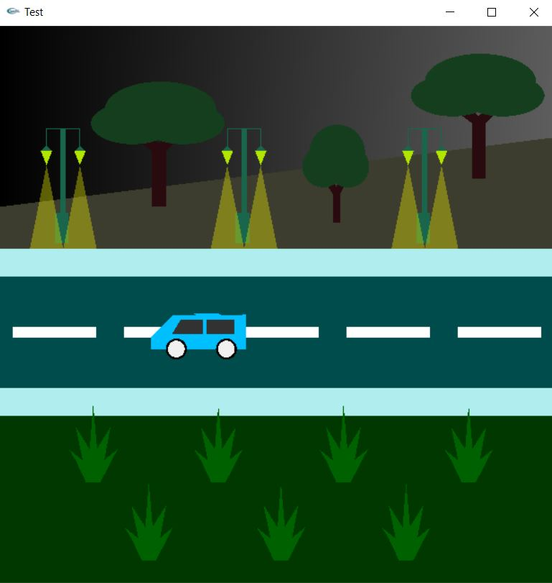
Day view: Night view:
→

Slide 4
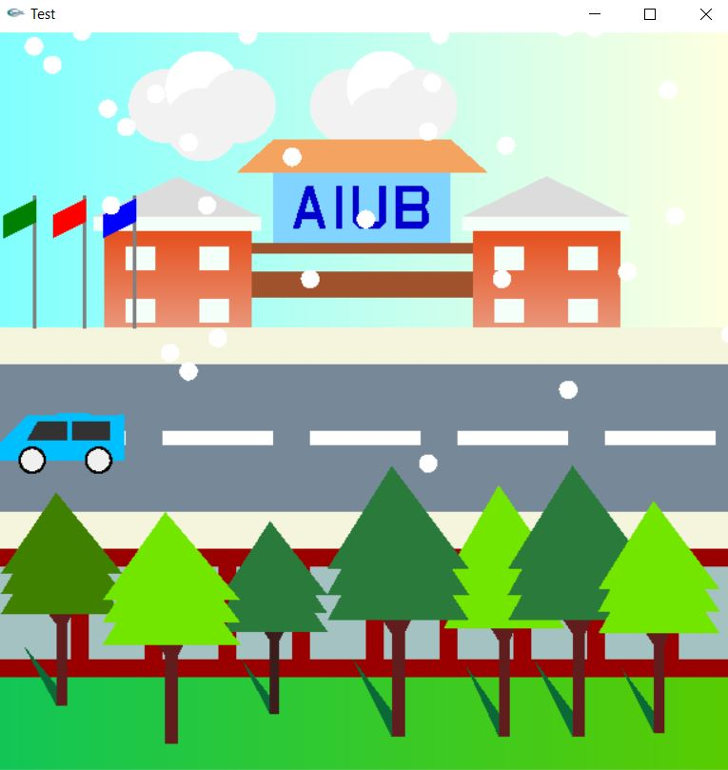
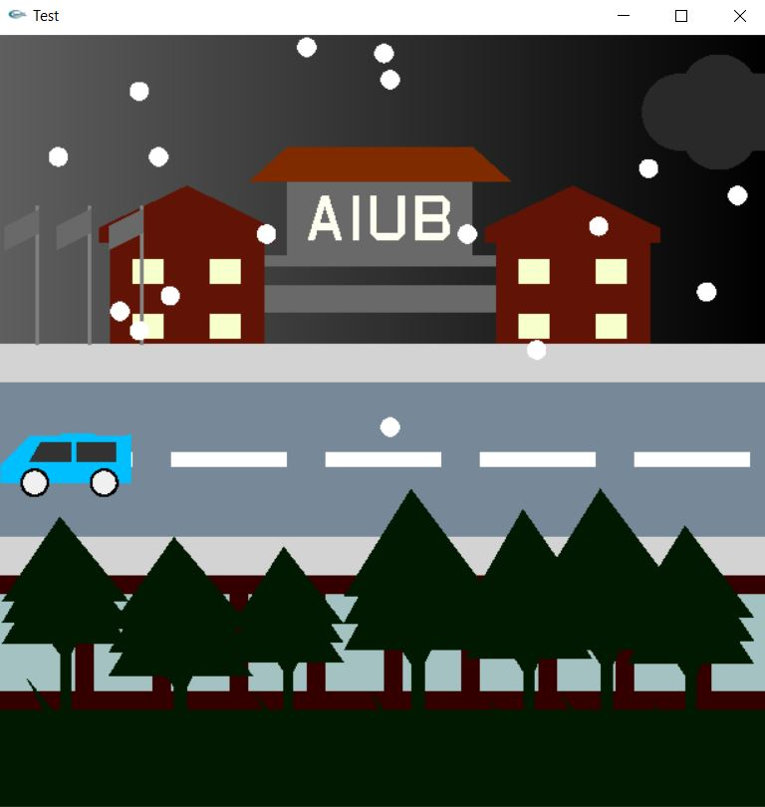
Day view: Night view:
→

Slide 5
Moving Object:
The Sun will be moving While the weather is Day

Slide 6
Moving Object:
The Clouds & Snow are moving in
a specific time cycle

Slide 7
User Interaction:
We can move the car by pressing
keys from keyboard

Slide 8
Ambient:
We have created ambient by overlapping different intensity of colors.
Created Ambient:

Slide 9
Ambient:
Sky color created
by Ambient:

Slide 10
Projection
Showing the 2D view of
different objects
This shapes are created by pointing
different coordinates

Slide 11
Lights & Shadows
Lights & shadows are created by
different colors & shapes
Showing different status of light
Created Shadow by a shape

Slide 12
Thank You

